Slide 4
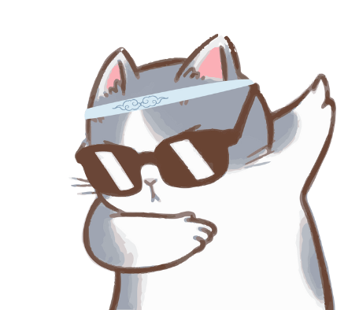
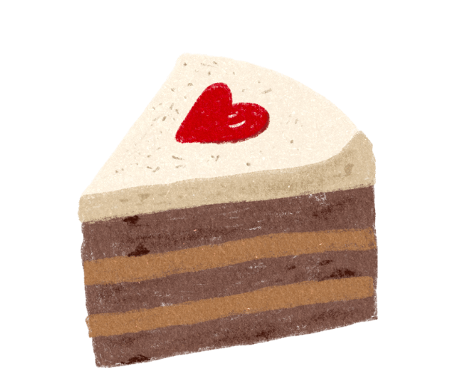
Piece of cake!
Mačji kašalj!

Slide 5
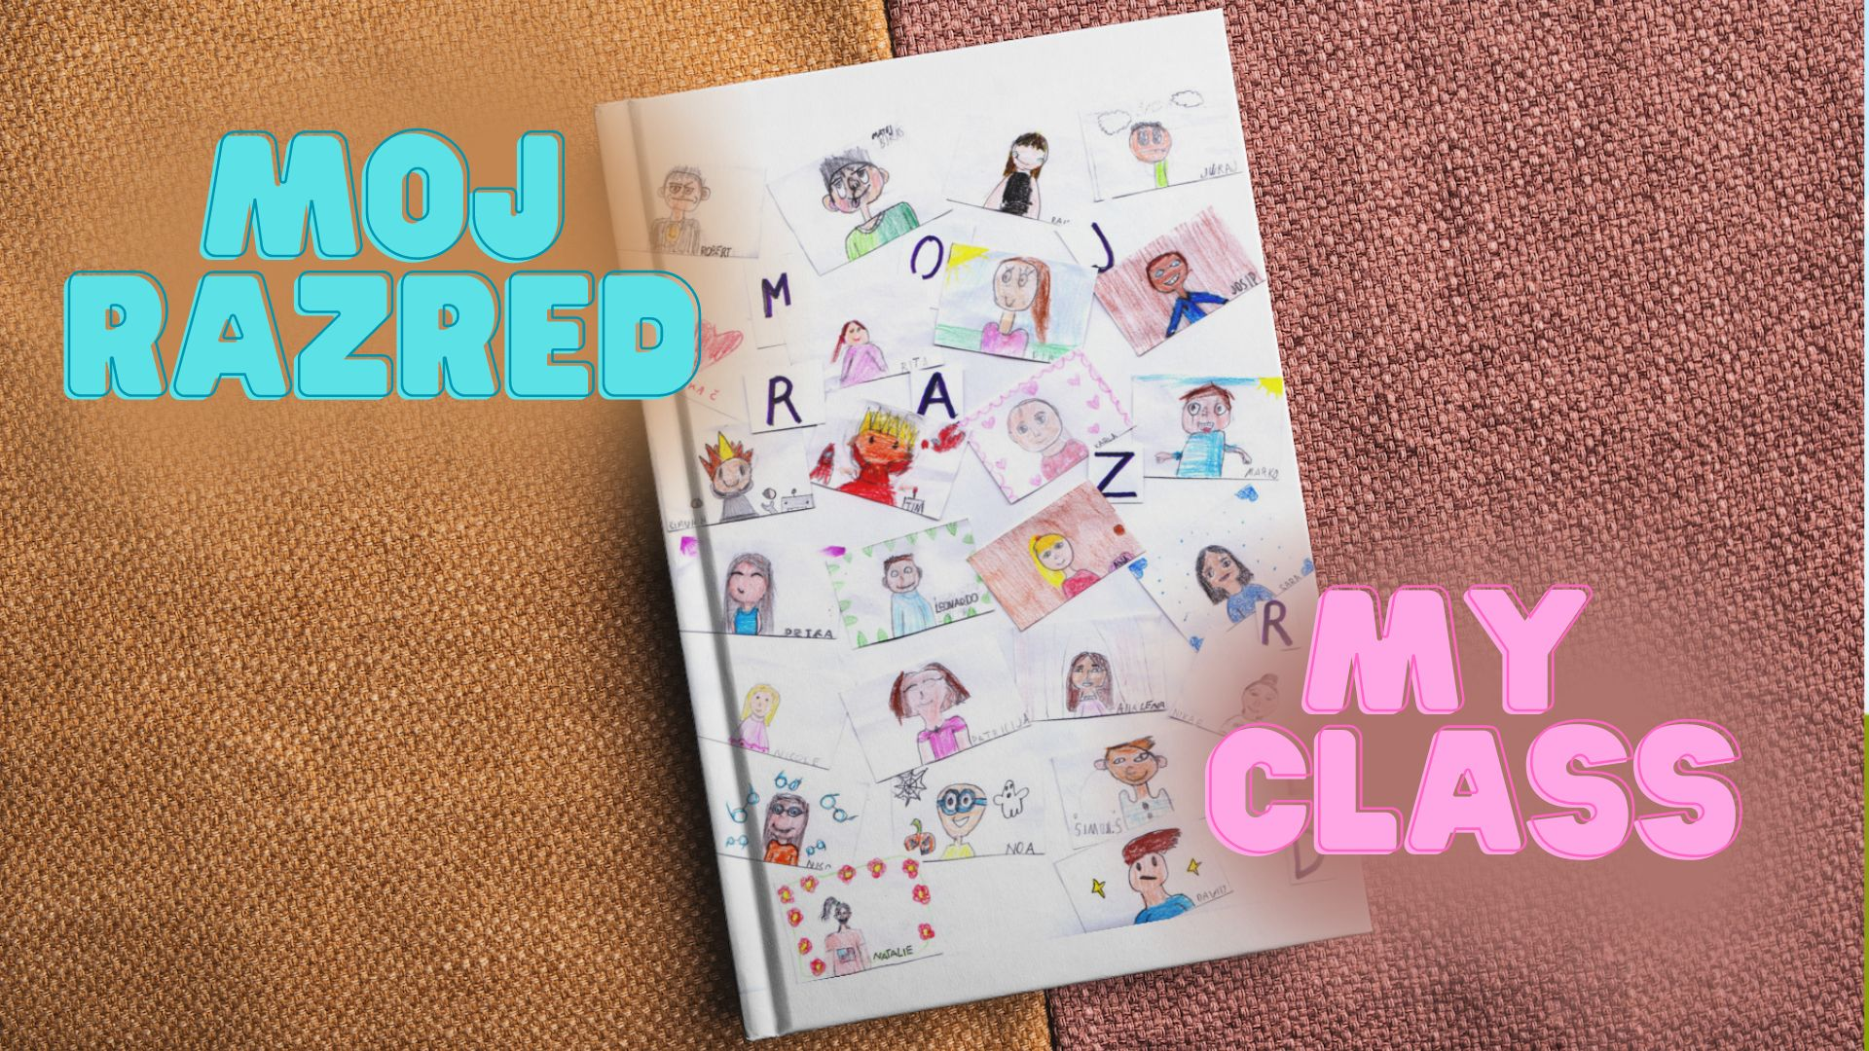

Slide 6
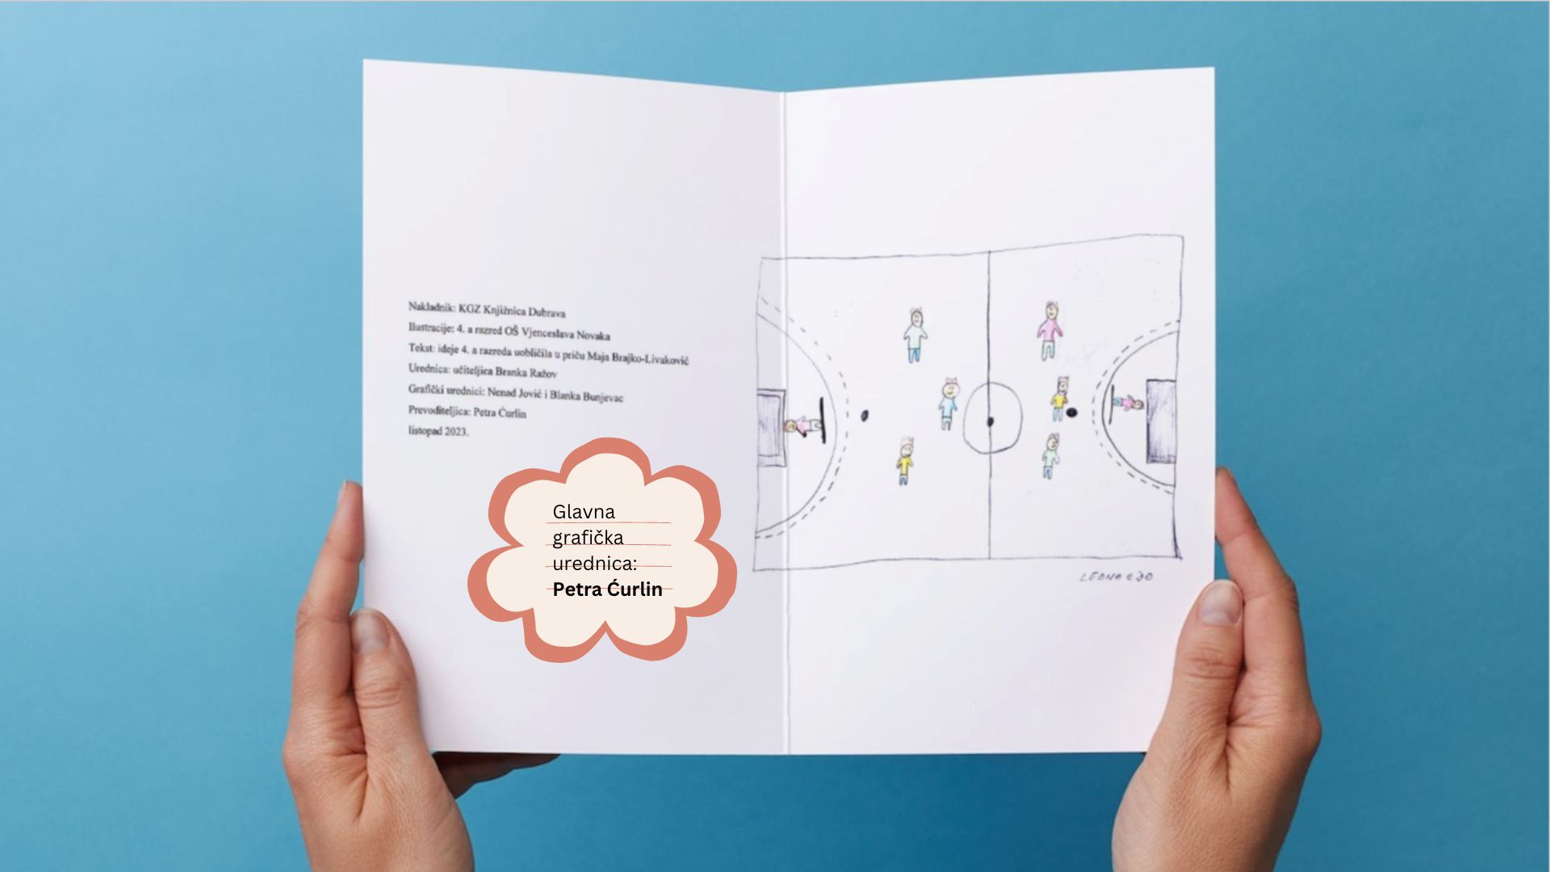

Slide 7
Bog!
Kako se zoveš?
Kako ti je prezime?
Koliko imaš godina?
Hi!
What's your name?
What's your last name?
How old are you?

Slide 8
Ja imam deset godina i deset i deset… tako dvadeset i pet puta.
Kako to, možda ćeš pitati?
I'm ten, and ten and ten and ten... times twenty-five.
“How so?“ you may ask.

Slide 9
I zovem se Raina, Nika Č., Matej, Ana Lena, Nika P., Marko, Juraj, Sara, Karla, Natalie, Petra, Patricija, Rita, David, Ana, Josip, Noa, Niko, Nicole, Pia, Šimun H., Šimun Š., David, Robert i Tin.
And my name is Raina, Nika Č., Matej, Ana Lena, Nika P., Marko, Juraj, Sara, Karla, Natalie, Petra, Patricija, Rita, David, Ana, Josip, Noa, Niko, Nicole, Pia, Šimun H., Šimun Š., David, Robert and Tin.

Slide 10
Ništa čudno. Mi smo 4. a razred OŠ Vjenceslava Novaka. Pričat ću vam o nama. Malo ja, malo drugi, ali onako da se ne primijeti.
Nothing odd. We are class 4a of Vjenceslav Novak Elementary School. I'll tell you about us. I'll tell some, others will take over, so you can't tell the difference.

Slide 11
Svatko od nas je drugačiji, ali zajedno smo odlična ekipa. Naš kapetan je učiteljica Branka.
Jako je volimo.
Nju i ostale učiteljice.
Each one of us is different, but together we make a great team. Our captain is our teacher Branka. We love her very much.
Her and the other teachers.

Slide 12
I što još volimo?
What else do we love?

Slide 13
Volimo svoje prijatelje i prijateljice s kojima idemo u isti razred.
We love our friends and classmates.

Slide 14
Volimo kada slavimo rođendane i dijelimo slatkiše. Kada negdje otputujemo, kao kad smo u 3. razredu putovali na more ili bili u Školi u prirodi.
We love to celebrate birthdays and share sweets. We love travelling, like the time we went to the seaside or had Outdoor School in the 3rd grade.

Slide 15
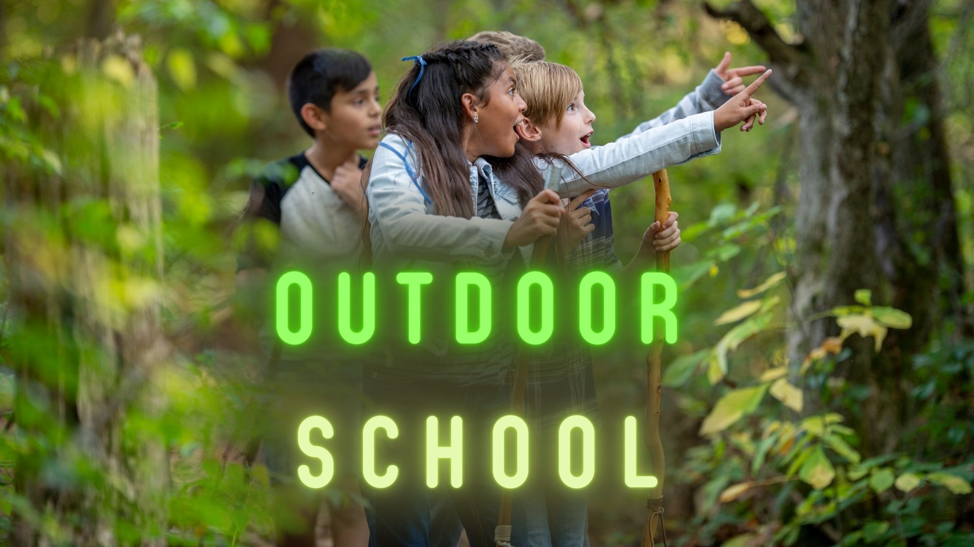

Slide 16
Mnogi od nas vole različite sportove, naročito nogomet. Nismo neki top nogometaši jer se jednom dogodilo da nikako nismo uspijevali zabiti gol već je lopta stalno tresla stative.
Many of us love different sports, especially football. We're not some top-level football players because one time we just couldn't score a goal, the ball kept shaking the goal posts.

Slide 17
Neki vole više matematiku, neki glazbeni, neki tjelesni, hrvatski, likovni…
Some like Maths, some Music, some Croatian, Art...

Slide 19
Volimo školu jer je zabavna. Puno toga naučimo. Volimo se družiti i zbijati šale, igrati se pokvarenog telefona kao jednom kad je od : „volim jesti pizzu za večeru“ ispalo „slon vozi pizzu u svemir.“
We love school because it's fun. We learn a lot. We love to hang out and make jokes, play Chinese whispers, like that one time when “I want to stuff my face with pizza“ turned to “The elephant goes to space with pizza.“

Slide 20
Smijali smo se i smijali i još se uvijek smijemo kad se toga sjetimo.
We laughed and laughed and we still laugh when we think of that.

Slide 21
Volimo lutkare, robote… ali i brbljati pod satom šššmmmrnnnnšššš… a onda nešto krivo čujemo i padamo iz svemira… možda iz onog u kojem je slon vozio pizzu…
We love to make puppets, robots... but we also like to whisper in class shhhwhishwhooshhhh… and then we get something wrong and we're all spaced out. Like that elephant that went to space with pizza...

Slide 22
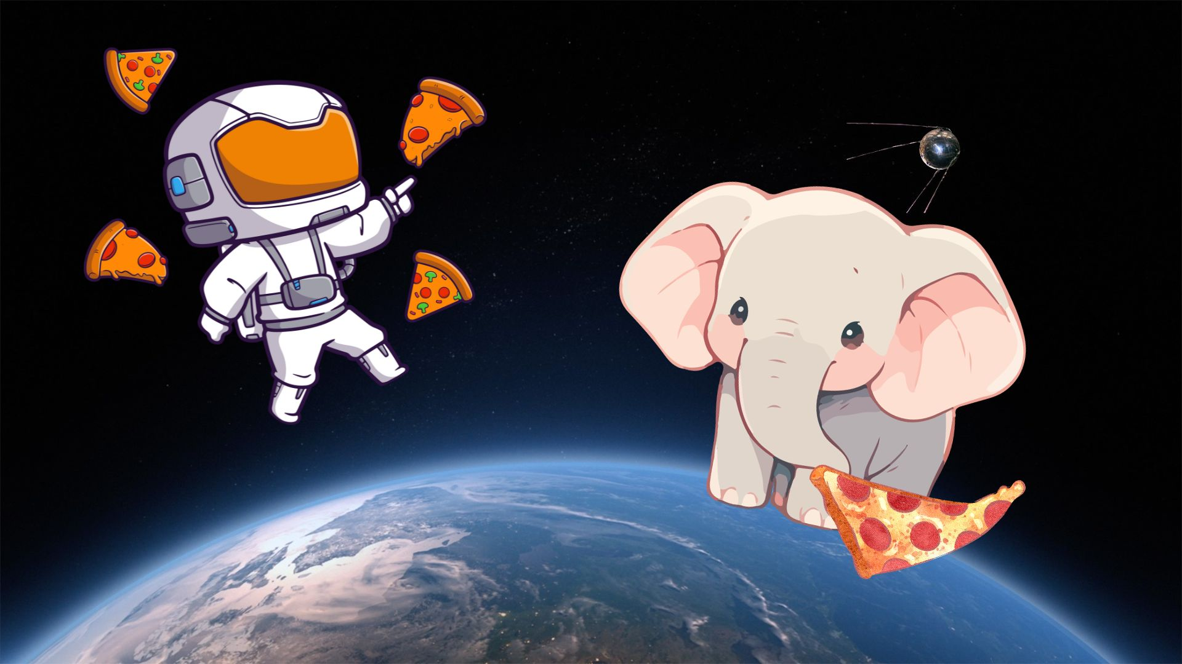

Slide 23
Ha-ha-haaaa, smije nam se…
Ha-ha-haaaa, we feel like laughing…

Slide 24
Ponekad izbiju svađe.
Sometimes fights break out.

Slide 25
To nitko od nas ne voli.
Nobody likes those.

Slide 26
Ponekad netko digne nos i ne želi se družiti s ostalima, a ponekad se dogodi da je netko osamljen…
Some of us can get full of themselves and not want to hang out with the rest, and some of us can be lonely...

Slide 27
To dozna i učiteljica Branka pa nam priča kako se moramo ponašati jedni prema drugima, a posebno prema starijima…
Teacher Branka always finds out about these things and then she tells us how to treat each other, especially our elders...

Slide 28
Bude nam žao, pa se pomirimo, pa nasmijemo… Volimo s smijati i smijati i smijati.
Then we're sorry, so we make up, and we laugh... We love to laugh and laugh and laugh.

Slide 29
Ponekad smijeh obojimo bojama, ponekad slatkišima, ponekad suzama, a najdraže nam je kad se učiteljica Branka s nama smije i od radosti plače.
Sometimes we paint the laughter with colours, sometimes with sweets, sometimes with tears, but our favourite is when teacher Branka laughs with us and cries for joy.

Slide 30
Volim svoj razred.
I love my class.

Slide 31
Volimo svoj razred.
We love our class.

Slide 32
Jako.
A lot.

Slide 33
Prejako. ☺ ☺ ☺
All the way. ☺ ☺ ☺

